Slide 1
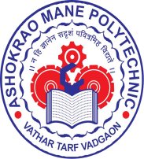
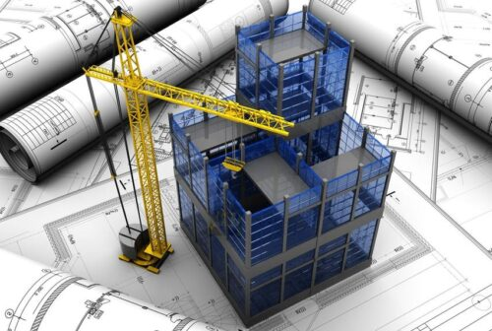
ASHOKRAO MANE POLYTECHNIC
DEPARTMENT OF CIVIL ENGINEERING
NEWS LETTER: TECHNOZEAL
VOL-9 : ISSUE-2 MAY 2024
THEME OF THE NEXT ISSUE:
DRONE SURVEYING
THEME :- EMERGING TRENDS IN CIVIL ENGINEERING
INSTITUTE VISION
Achieve excellence in quality technical education to create competent technocrats with ethical and social responsibilities for the betterment of society.
MISSION
M1- To provide a scholarly and vibrant learning environment that enables students to achieve professional growth.
M2- To impart quality technical education with emerging technology to fulfill industrial requirements.
M3- To develop culture for holistic development of an individual including social as well as ethical responsibilities.
M4- To strengthen relationship with industries for empowering the students to work in adverse conditions.
ABOUT INSTITUTE
Meeting and coping with the emerging challenges is the prime function of today's students. To do this, it requires keen perception, flexibility and the ability to merge theories into action plans.
Shri Balasaheb Mane Shikshan Prasarak Mandal Ambap’s, Ashokrao Mane Polytechnic, Vathar Tarf Vadgaon (AMPV) was established in 2008 and is located near Kolhapur. This Institute has AICTE approval for the Six Diploma courses. AMPV has emerged as a leading technological institute to promote Technical Education for rural communities.
AMP believe in providing students with hands-on training that will further hone their technical skills with soft skills. We believe in giving our students, the competitive advantage in the business world, by encouraging them to be inquisitive and make informed choices.
Apart from the prescribed curriculum by the MSBTE, our college structures customized special programs based on specific requirements of the industry with a focus on priorities. Periodic quality audits are conducted to ensure effective teaching, class room management, efficient documentation and judicious review of teaching learning process.
INSIDE :
DEPARTMENTAL NEWS
MESSAGE FROM PRINCIPAL
FROM EDITORS DESK
TECHNICAL EVENT
OTHER ACTIVITY
FACULTY SPEAK
STUDENTS SPEAK
EXPERT LECTURES
ACHIEVEMENT
EXTRA ACTIVITY
SUCCESS STORY
ABOUT THE THEME
CHIEF EDITOR :
MR. A. B. WARKE
EDITOR COMMITTEE:
MR. J. M. JADHAV
MRS. M. A. CHAVAN
MISS. KIRAN PATIL
MR. ABHIJEET LANDAGE
MISS. DIYA. SANADE
The road to success is always under construction
ASHOKRAO MANE POLYTECHNIC, VATHAR PAGE NO 1

Slide 2
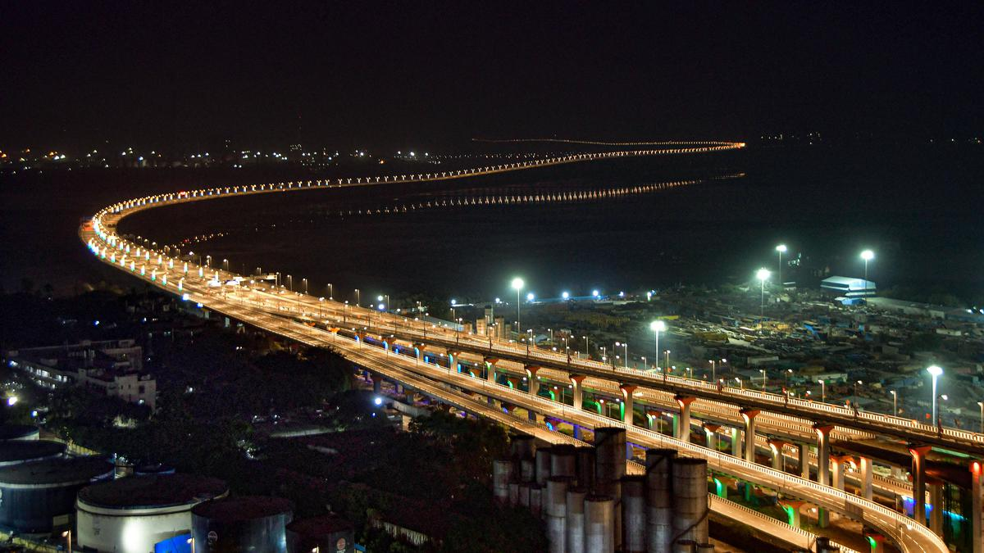
The department of civil engineering was stared in the academic year 2009-2010 with an aim of promoting high quality education in the field of civil engineering. The academic activities of the department are emphasis deep understanding of fundamental principles, development of creative ability to handle the challenges of civil engineering and the analytical ability to solve the problems which are interdisciplinary in nature. The department currently offers Diploma in Civil Engineering a program following in the Maharashtra State Board of Technical Education, Mumbai (MSBTE) curriculum. The curriculum broadly covers the engineering subjects of related field such as Surveying, Building Materials and Construction, Geo Technical Engineering, Design of Steel and RCC Structure, Hydraulics and Irrigation Engineering, Public Health Engineering, Solid Waste Management, Highway Engineering etc. The teaching is assisted with digitalized presentations for better understanding of the students. Industrial visits are arranged for students to gain practical experience. Every year a technical symposium REFLEX is organized for students to explore the knowledge and interact with other college students. Department magazine is published yearly to develop and improve their inter personal skills. The students are motivated by Development programmers like CESA (Civil Engineering students association). The Civil Engineering Students Association (CESA) is working effectively to share the information and to help the society.
DEPARTMENT OF CIVIL ENGINEERING DEPARTMENTAL NEWS
VISION AND MISSION OF DEPARTMENT
ABOUT DEPARTMENT
VISION
Strive to develop competent civil engineers, with academic excellence, knowledge and quality education to make significant contributions in holistic growth of society.
MISSION
m1 - To impart quality education with strong experimental knowledge.
m2 - To provide our students the latest learning techniques and modern materials knowledge in all sectors to make them nationally recognizable civil engineer.
m3 - To provide a dynamic learning environment that emphasis on problem solving skills, team work, and communication and leadership skills.
m4 - To train students with soft skills and other training programs for their future jobs and higher studies.
Longest Sea Bridge of India : Atal Bihari Vajpayee Sewri–Nhava Sheva Atal Setu
"Building the future with innovation and sustainability, where every structure tells a story of resilience and vision."
- John Prebble
"Civil Engineering is the art of directing the great sources of power in nature for the use and convenience of man." - Thomas Tredgold
ASHOKRAO MANE POLYTECHNIC, VATHAR PAGE NO 2

Slide 3
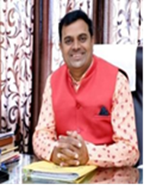
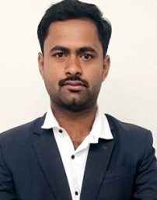
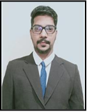
DEPARTMENT OF CIVIL ENGINEERING FROM EDITORS DESK
MESSAGE FROM PRINCIPALS DESK
institutions etc.
The Civil Engineering department has well equipped with laboratories to perform experiments and endeavor to provide better technical facilities in days to come. Our focus is on excellence teaching and training the students with emphasis to well equip them for challenges and opportunities. It gives immense pleasure to lead the Department of Civil Engineering.
Mr. A. B. Warke
Head
Department of Civil Engineering
Dear Readers,
Best wishes for new edition. This Newsletter is an initiative by Civil Department which has a specific purpose in it. The contribution made so far by the teachers, students, academicians and industrialists has compelled to promote such moves in the era of new technologies such as Artificial Intelligence, Machine Learning, Internet of Things(IoT), etc. This newsletter is also acting as a medium to convey messages about its vision and values along with future strategies and plans. This newsletter has a unique theme “Emerging Trends in Civil Engineering”, the trends which are widely adopted now a days in construction industry. I appreciate the editing team, which is putting efforts of compiling various news about diploma education system in department along with views and information about a relevant theme and disseminating it to a cohesive community of stakeholders ,students, faculty, parents, administrators, institutes, industry and community at large - through this Newsletter.
Prof. Y. R. Gurav Principal,
AMP VATHAR
MESSAGE FROM EDITORIAL BOARD
Dear Readers,
Welcome to the latest edition of our Civil Engineering Department Newsletter - TECHNOZEAL!
In this issue, we are excited to bring you a diverse range of articles, updates, and insights from the world of civil engineering. Our department continues to thrive with research, innovative projects, and impactful collaborations both within the college and beyond. As we navigate through these dynamic times in the field of civil engineering, it is essential to stay informed and connected. We encourage you to explore the contents of this edition, engage with the stories shared by our faculty, students, and alumni's and discover the latest advancements shaping the future of our discipline.
Thank you to all our contributors and readers for your continued support and enthusiasm. Together, let us continue to build a brighter future through civil engineering excellence.
Best regards,
Mr. J. M. Jadhav
Editorial Board Civil Engineering Department
MESSAGE FROM HOD DESK
Construction industry is currently growing with latest technologies and now there is a huge demand for civil engineers for satisfying the demand of infrastructural development. Civil engineers will always be needed to maintain and repair the existing facilities and structures, and to construct new ones. The service of civil engineers is inevitable in the entire government department in the modern race. Not only in government department but also in private and public sector, research and educational
ASHOKRAO MANE POLYTECHNIC, VATHAR PAGE NO 3

Slide 4
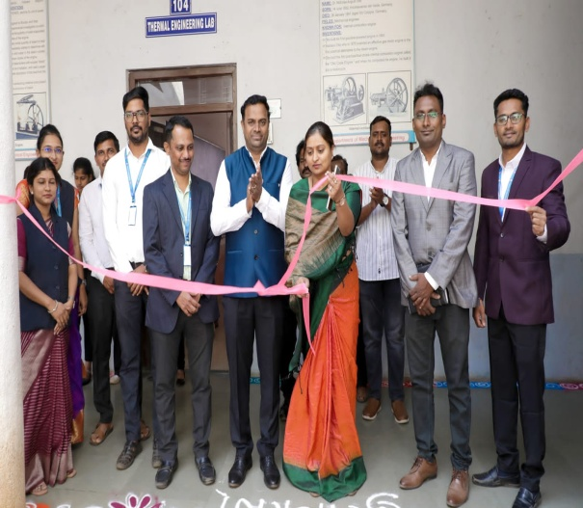
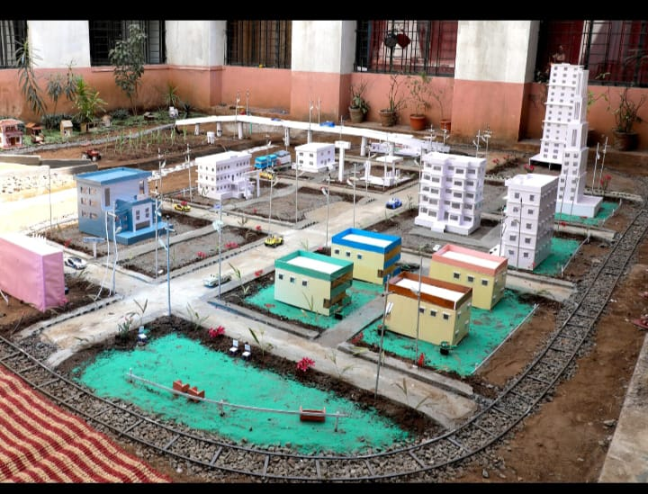
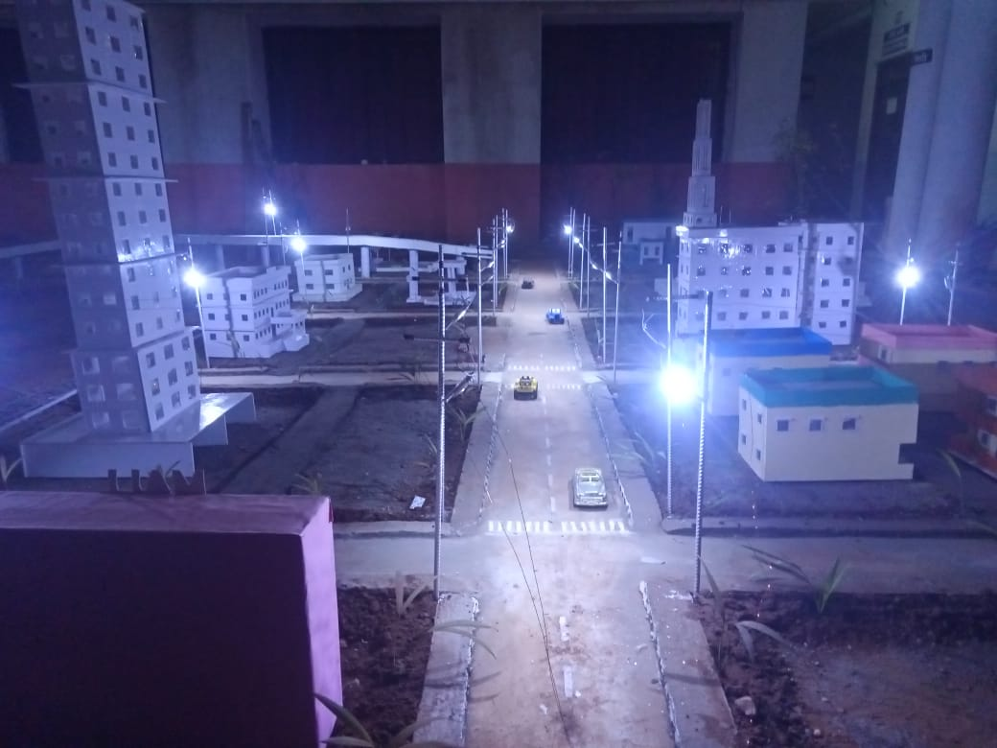
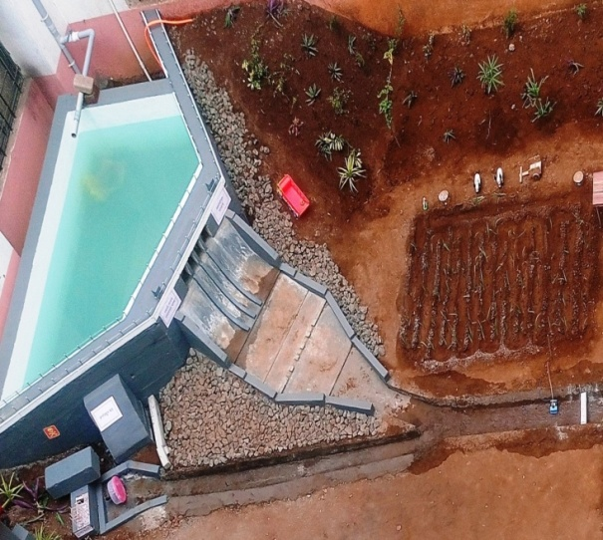
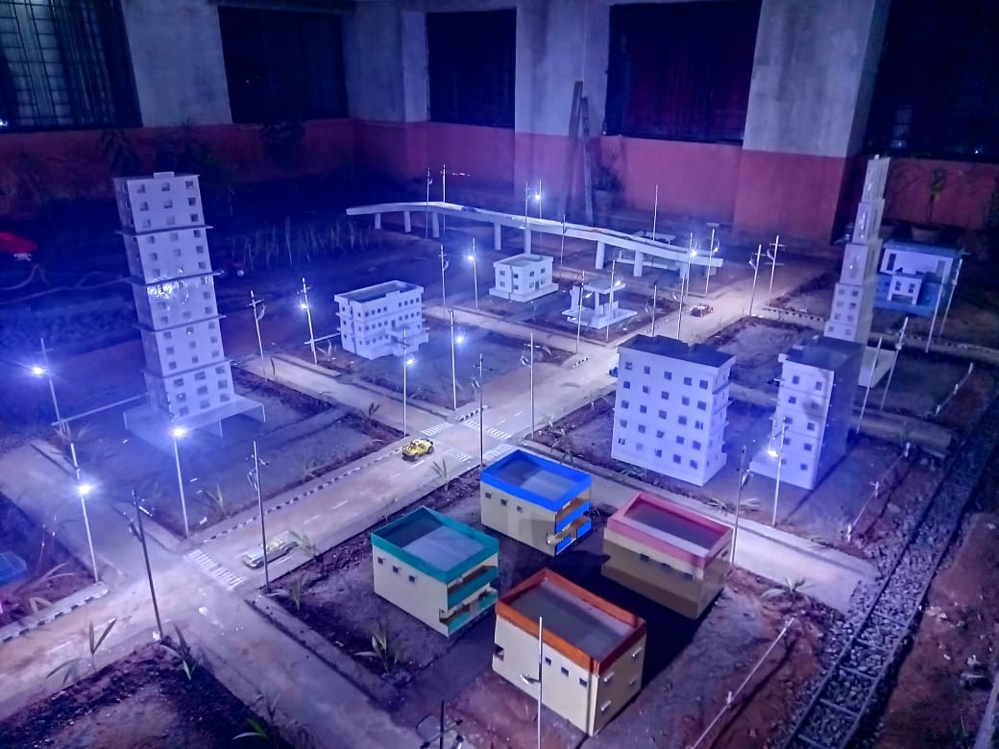
DEPARTMENT OF CIVIL ENGINEERING TECHNICAL EVENT
SMART CITY MODEL
The inauguration of “Smart City Model and Radhanagari Dam Model” by Hon. sou. Manisha Vijaysinh Mane (Ex member, ZP Kolhapur) in presence of Prof. Y. R. Gurav, Principal Ashokrao Mane Polytechnic, Vathar tarf Vadgaon.
VIEW OF SMART CITY DURING DAY
Smart City Model made by students of civil engineering department showcases all the elements of a Smart City such as, Smart Transportation, Smart Waste Collection, Smart Drainage System, Smart Electricity Consumption Etc.
VIEW OF RADHANAGARI DAM MODEL
Creating a smart city model is an exciting project that made involvement of various aspects of civil engineering. The model gives practical knowledge about components of Dam, Hydro power generation & Irrigation system, regarding layout and construction of smart city, Railway track and fly over bridge. When civil engineering students collaborate on such a project, they does not only learn about traditional civil engineering principles but also gain exposure to cutting-edge technologies and interdisciplinary approaches, essential for building the cities of the future. This hands-on experience made them prepare to address real-world urban challenges and contribute to sustainable development goals.
VIEW OF SMART CITY AT NIGHT
ASHOKRAO MANE POLYTECHNIC, VATHAR PAGE NO 4

Slide 5
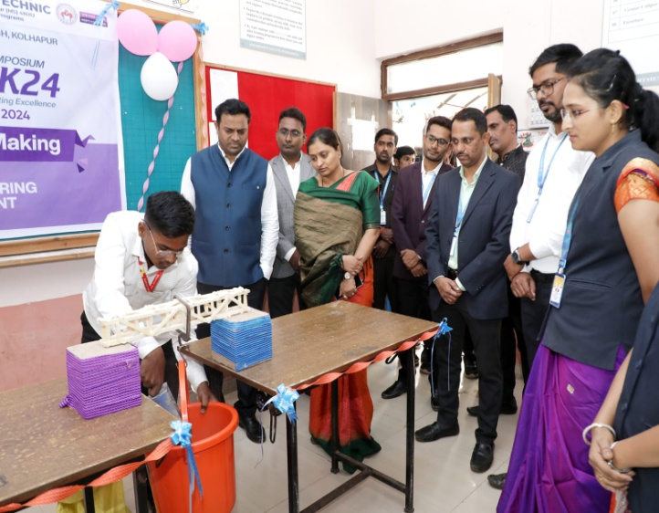
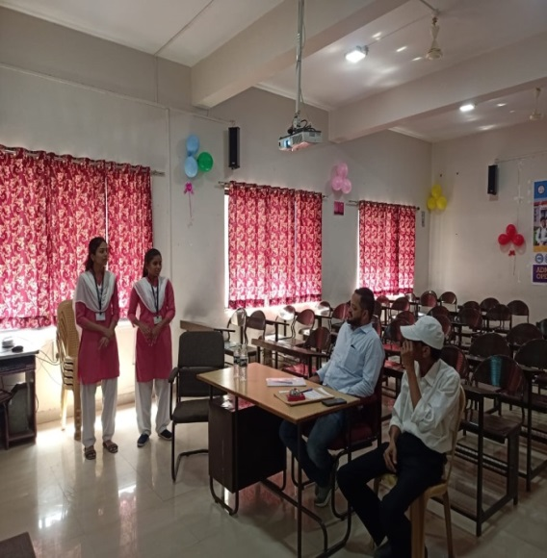
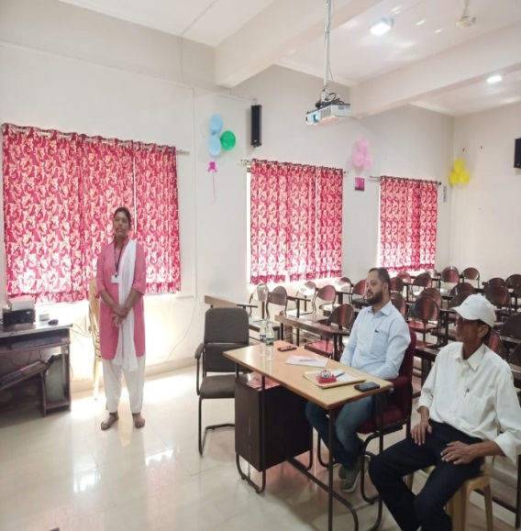
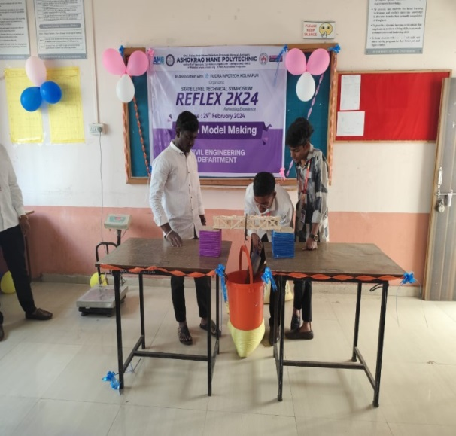
DEPARTMENT OF CIVIL ENGINEERING TECHNICAL EVENT
REFLEX 2K24
BEAM MODEL MAKING
PAPER PRESENTATION
The inauguration of “Beam Model Making Competition” by Hon. sou. Manisha Vijaysinh Mane (Ex member ZP Kolhapur) in presence of Prof. Y. R. Gurav, Principal, Ashokrao Mane Polytechnic, Vathar tarf Vadgaon.
Participants presenting their seminar at Paper Presentation Competition conducted by Department of Civil Engineering
Beam Model Making competition among civil engineering students creates a fantastic opportunity to showcase creativity, engineering skills, and knowledge of structural principle. A beam model making competition does not only enhances technical skills but also encourages creativity, teamwork, and practical application of engineering principles among the participants. It made a memorable and valuable experience for civil engineering students, preparing them for future challenges in the field of structural engineering and beyond. Students got practical experience in designing and building structural components, applying theoretical knowledge to a real-world problem.
The Civil Engineering Paper Presentation Competition showcased a diverse array of innovative research and cutting-edge developments in the field. Participants from various academic institutions presented their papers on topics ranging from structural engineering and transportation to environmental sustainability and construction management. This event provided a platform for networking among participants and judges. It facilitated discussions on potential collaborations, future research directions, and career opportunities within the civil engineering community.
ASHOKRAO MANE POLYTECHNIC, VATHAR PAGE NO 5

Slide 6
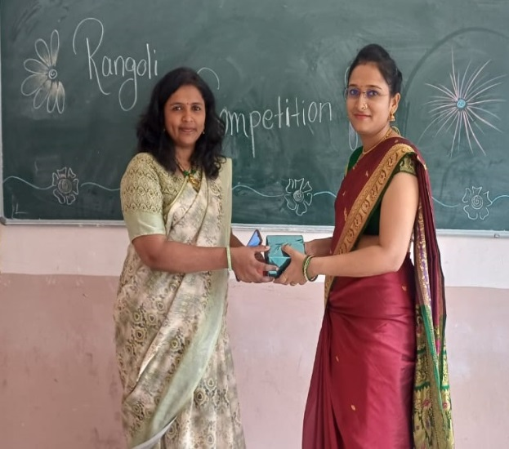
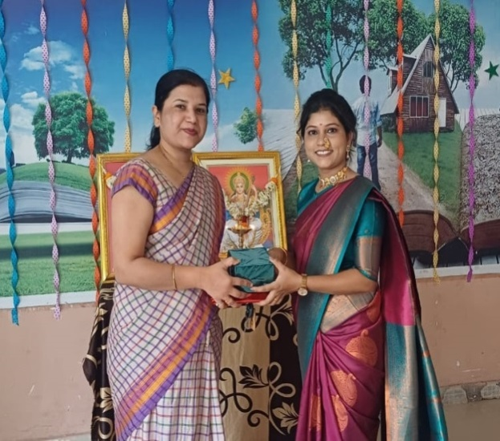
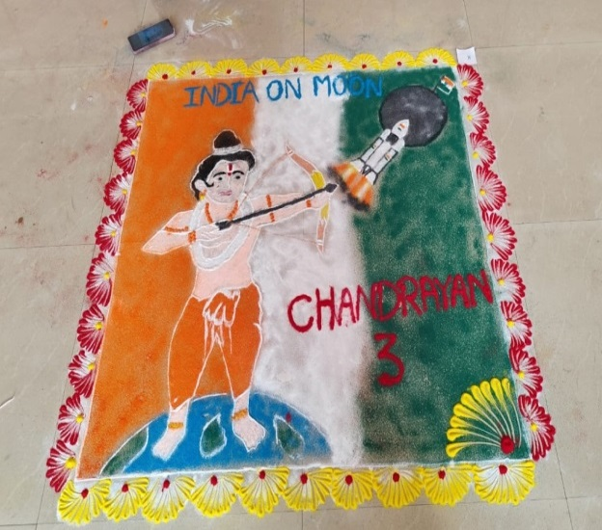
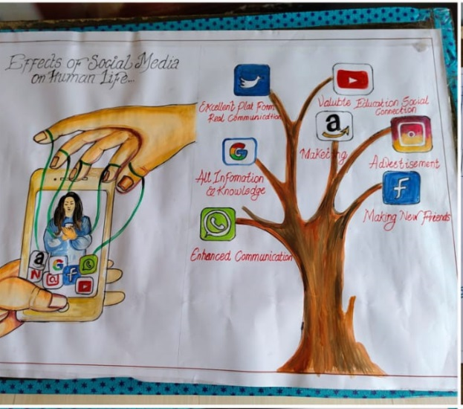
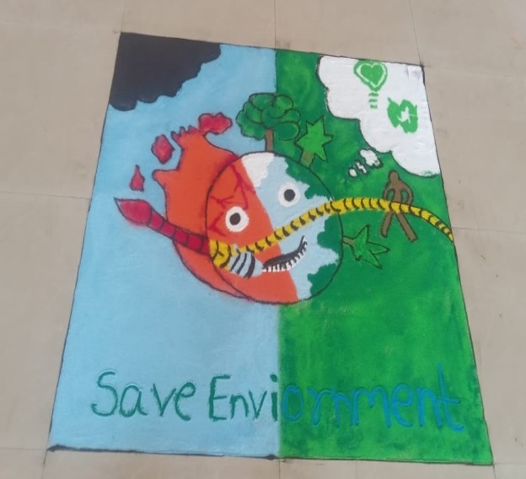
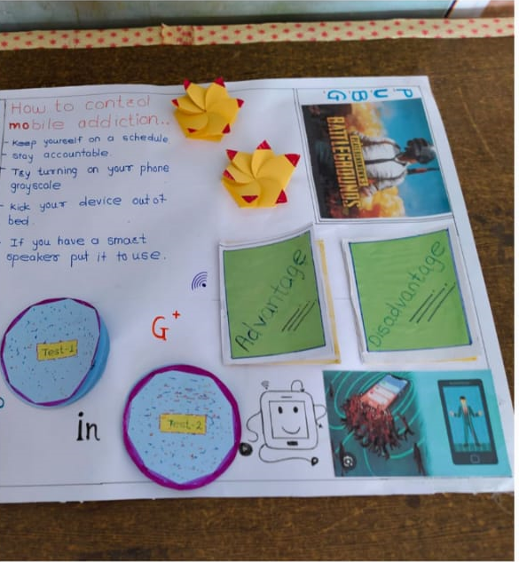
DEPARTMENT OF CIVIL ENGINEERING OTHER ACTIVITY
DEPARTMENT OF CIVIL ENGINEERING REFLEX 2K24
ANNUAL FUNCTION 2K24
RANGOLI COMPETITION
POSTER PRESENTATION COMPETITION
The inauguration of Rangoli Competition by Mrs. Satwashila Kadam Mam.
The inauguration of Poster Presentation Competition by Dr. Shubhangi Sutar Mam.
Rangoli made by participants in Rangoli Competition organized by Civil Engineering Department at Annual Function Kalavishkar 2k24
Posters presented by participants in Poster Presentation Competition organized by Civil Engineering Department at Annual Function Kalavishkar 2k24
ASHOKRAO MANE POLYTECHNIC, VATHAR PAGE NO 6

Slide 7
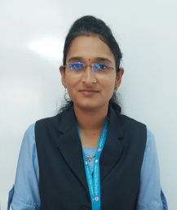
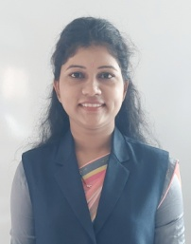
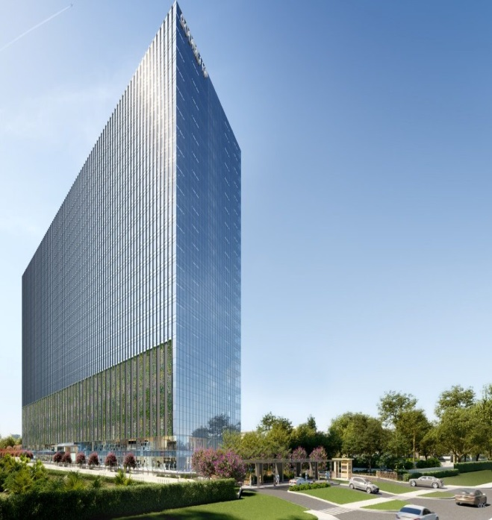
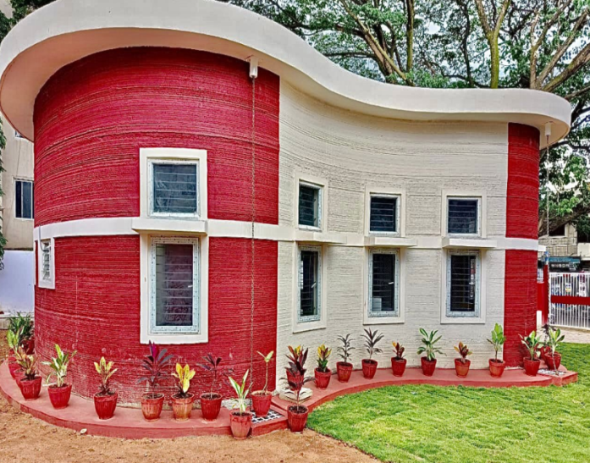
DEPARTMENT OF CIVIL ENGINEERING FACULTY SPEAK
FACULTY SPEAK
3D Printing: A Revolution
In Construction Industry
Building Information Modeling ( BIM):
A Transformative Approach
3D printing, also known as additive manufacturing, has rapidly gained traction across various industries for its ability to create complex structures layer by layer with unprecedented precision. In civil engineering, this technology is revolutionizing the traditional methods of construction, offering numerous advantages that were once unimaginable. Firstly, 3D printing in civil engineering dramatically reduces construction time. Traditional methods often involve assembling structures piece by piece, which can take months or even years for large-scale projects. With 3D printing, buildings can be constructed in a matter of days or weeks, significantly accelerating the pace of development. Moreover, this technology enhances architectural flexibility. It enables architects and engineers to explore intricate designs that were previously difficult or costly to realize with conventional techniques. From curved facades to organic shapes, 3D printing opens up a new realm of possibilities for creativity and innovation in urban design.
Imagine disaster-resistant shelters rapidly printed in areas affected by natural disasters, or affordable housing solutions swiftly deployed to address urban housing shortages. These scenarios are not far-fetched dreams but achievable goals with the continued advancement of 3D printing technology.
Miss. K. M. Sapkal
Lecturer,
Civil Engineering Department
Building Information Modeling (BIM) has become a standard practice, enabling multidisciplinary teams to collaborate more effectively and visualize entire projects in a virtual environment before construction begins. The use of drones and satellite imaging is improving site surveying and monitoring, providing real-time data for better decision-making and project management.
Additionally, the concept of smart cities is gaining momentum worldwide. Civil engineers are at the forefront of designing infrastructure that supports interconnected systems for transportation, energy, and communication. These cities leverage data and technology to enhance efficiency, sustainability, and quality of life for residents. In conclusion, the field of civil engineering is dynamic and ever-evolving, driven by innovation and the desire to create a better future for generations to come. As aspiring engineers, it is our responsibility to embrace these emerging trends, think critically, and contribute to solutions that address global challenges such as urbanization, climate change, and resource scarcity.
Mrs. M. A. Chavan
Lecturer,
Civil Engineering Department
The first 3D printed building in India
Cambridge Layout Post Office , Bangalore
The BIM model of a building in India
GFM Godrej Projects KP and Bangalore
ASHOKRAO MANE POLYTECHNIC, VATHAR PAGE NO 8

Slide 8
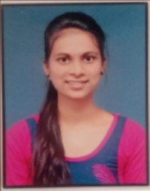
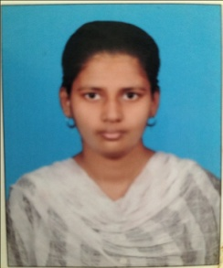
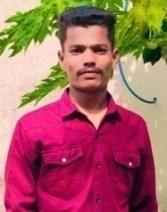
DEPARTMENT OF CIVIL ENGINEERING STUDENT’S SPEAK
STUDENT’S SPEAK
AR-VR : Transforming The Design and Construction Process
maintenance strategies facilitating informed decision-making and predictive how we design, operate, and maintain complex systems. At its core, a digital twin is not merely a simulation or a 3D model; it's a living model that evolves with its physical counterpart, constantly updated with data from sensors, IoT devices, and other sources. This real-time synchronization enables us to predict behavior, prevent failures, and improve performance of the project.
Mr. Abhijeet Landage
Student,
Second Year Civil
Augmented Reality and Virtual Reality are not just buzzwords, they are powerful tools that enable engineers and architects to visualize projects in ways previously unimaginable. AR overlays digital information onto the real world, enhancing our understanding of existing environments and facilitating seamless collaboration between stakeholders. VR, on the other hand, immerses users in entirely virtual environments, providing a realistic simulation of proposed designs and construction sequences.
One of the primary benefits of AR and VR in civil engineering is, enhanced visualization. Imagine standing on an empty lot and using AR glasses to see a proposed building fully rendered in its future surroundings. Engineers can assess how the structure fits within the landscape, analyze sightlines, and identify potential design conflicts—all before breaking ground. This capability not only improves design accuracy but also enhances client communication by offering a tangible preview of the final product.
Miss. Kiran Patil
Student,
Third Year Civil
Prefabricated Bathroom Pods
These are nothing but a bathroom fully assembled in a factory, complete with plumbing fixtures, electrical wiring, and finishes like tiles and mirrors. These bathroom pods are manufactured off-site under controlled conditions and then transported to the construction site for installation.
Prefabricated bathroom pods streamline construction timelines by eliminating the need for on-site coordination of multiple trades. The pods arrive ready-to-install, reducing construction time and labor costs significantly. Manufactured in a factory environment, bathroom pods undergo rigorous quality control measures. This ensures consistency in construction quality, adherence to building codes, and fewer defects compared to traditional on-site construction. Bathroom pods can be customized to fit different architectural styles and project requirements. Designers have flexibility in choosing finishes, fixtures, and layouts while ensuring uniformity across multiple units. Prefabricated bathroom pods contribute to sustainability goals by reducing construction waste generated on-site. Factory processes optimize material usage and recycling, minimizing environmental impact.
With much of the construction work completed off-site, there are fewer on-site hazards and risks to workers during installation. This promotes a safer working environment and reduces accidents.
Overall, prefabricated bathroom pods offer a streamlined, efficient, and flexible solution for integrating high-quality bathrooms into building projects of various scales and types. Their benefits make them increasingly popular in modern construction practices.
Miss. Diya S. Sanade
Student,
Third Year Civil
Digital Twin Technology : Reshaping The Construction Industry
Let me introduce you to a very transformative concept that is very reshaping industries and paving the way for the future of technology and innovation: Digital Twin Technology.
Imagine a virtual replica of a physical object, process, or system. This is what a digital twin is—a dynamic, real-time representation that allows us to monitor, analyze, and optimize its physical counterpart. From manufacturing plants and smart cities to healthcare systems and even individual consumer products, digital twins are revolutionizing
Digital twins are virtual replicas of physical assets, processes, or systems that enable real-time monitoring, analysis, and simulation. By integrating data from sensors, IoT devices, and other sources, digital twins provide a holistic view of infrastructure,
ASHOKRAO MANE POLYTECHNIC, VATHAR PAGE NO 7

Slide 9
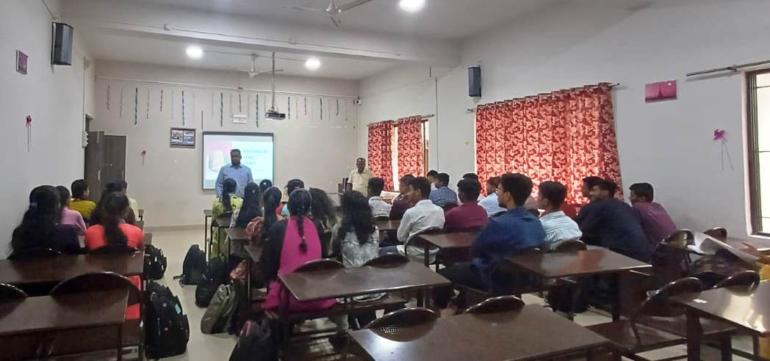
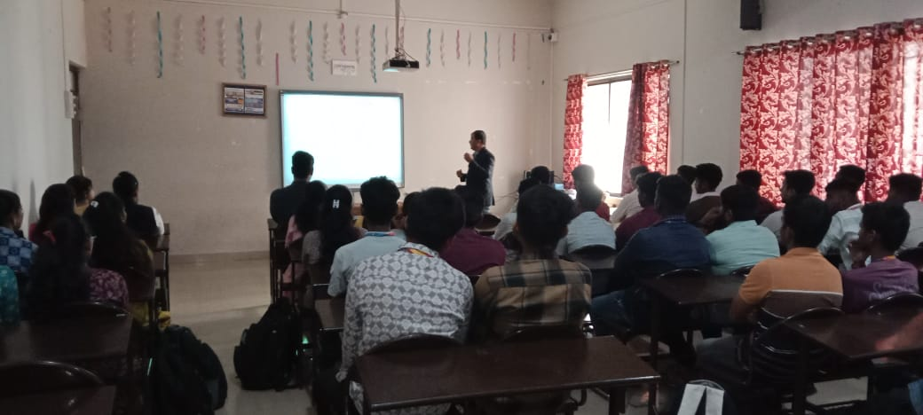
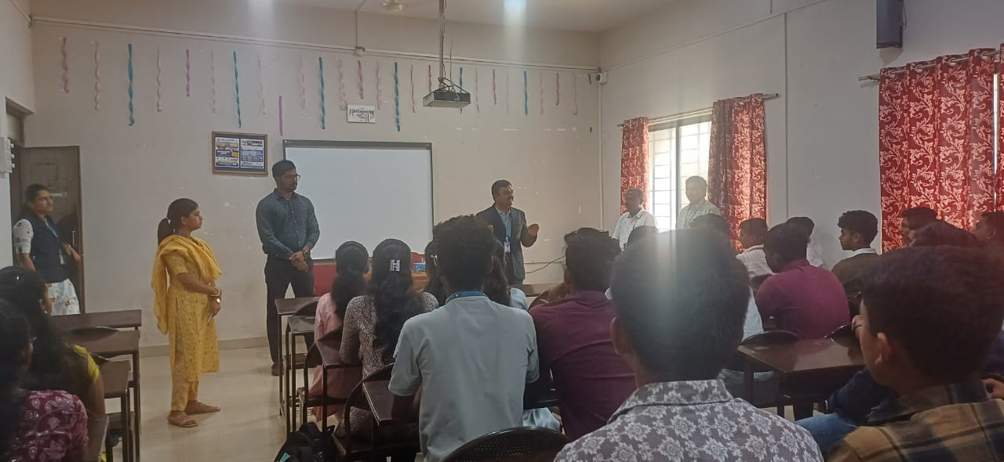
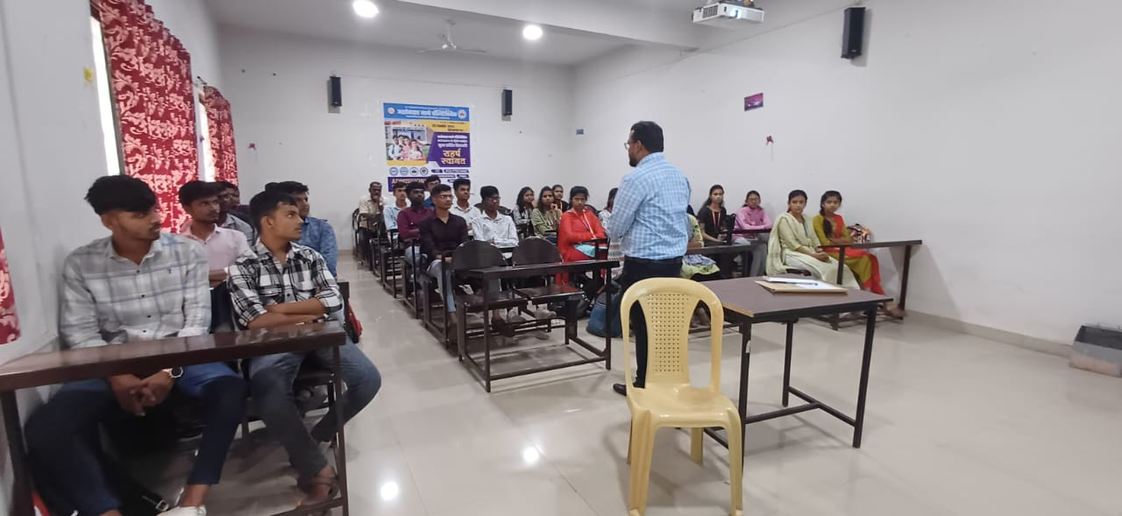
DEPARTMENT OF CIVIL ENGINEERING EXPERT LECTURES
EXPERT LECTURES
Skills Required to Become Successful Civil Engineer
Self Compacting Concrete: A Significant Advancement in the Field of Construction Materials
Mr. P. S. Koli, of Shri Swami Samarth Training Institute , Vathar Tarf Vadgaon guiding the students about skills required of future civil engineers.
Prof. Dr. J. M. Shinde ,Head , Civil Engineering Department, AMGOI, Vathar, guiding the students of civil engineering about self compacting concrete.
Becoming a successful civil engineer requires a diverse set of skills that extend beyond technical knowledge. While proficiency in civil engineering principles and practices is fundamental, other skills such as effective communication, problem-solving skills, project management and knowledge about advancement in the field are equally crucial. The whole purpose of arranging this type of guest lectures is to encourage civil engineering students to embrace the new technologies and stay updated with the latest advancements in the field.
Self Compacting Concrete represents not just a technological advancement but a paradigm shift in concrete construction. Offering sustainable, efficient, and high-performance solutions that align with the evolving needs of the construction industry and contribute to the development of resilient and sustainable infrastructure globally. This type of expert lectures helps to improve the knowledge about construction materials among the civil engineering students .
ASHOKRAO MANE POLYTECHNIC, VATHAR PAGE NO 9

Slide 10
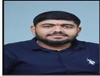
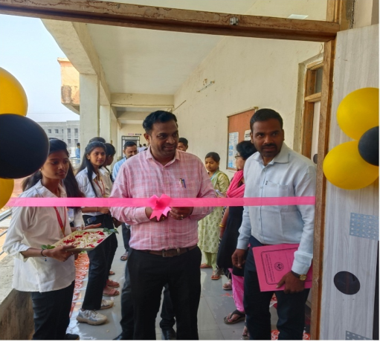
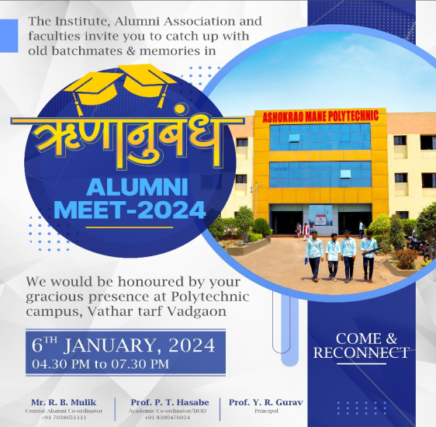
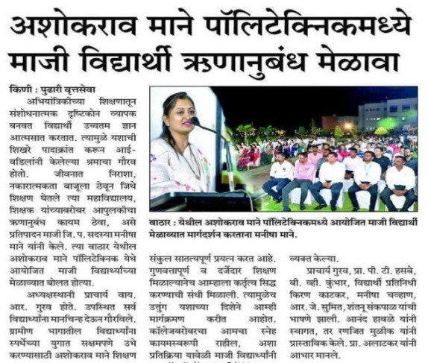
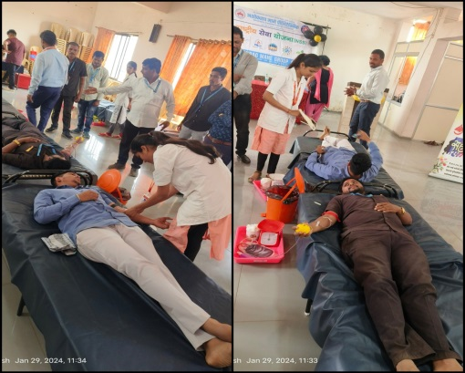
DEPARTMENT OF CIVIL ENGINEERING STUDENTS ACHIEVEMENT
ACADEMIC TOPPERS
THIRD YEAR
SECOND YEAR
Kiran K. Patil
Diya S. Sanade
Harshad S. Chougule
Abhijeet A. Landage
87.70%
85.20%
85.00%
76.11%
NSS ACTIVITY
ALUMINI MEET 2024
The inauguration of “Blood Donation Camp” by Prof. Y. R. Gurav, Principal, Ashokrao Mane Polytechnic, Vathar tarf Vadgaon.
The alumni meet held on 06/01/2024 was a resounding success, bringing together aluminizes from various classes spanning several years. The event was organized by the Alumni Association in collaboration with the college administration to celebrate the achievements of our alumni and foster stronger connections among former students.
The alumni meet was not only a platform for reminiscing about shared memories but also a testament to the enduring spirit and achievements of our alumni community. It reinforced the bond between alumni and the alma mater, inspiring all present to continue striving for excellence in their respective fields.
On the Occasion of Birthday of Hon. Sou. Manisha Mane (Ex-Member ZP Kolhapur) NSS committee of Ashokrao Mane Polytechnic, Vathar had arranged the “Blood Donation Camp” on 29/01/2024 in cooperation with the Sanjeevan Blood Center Kolhapur. All the HOD’s, departmental NSS coordinator and staff were present. Nearly about 52 students and staff participated in the camp spontaneously. By donating blood participants express their gratitude towards the society. This event gave complete satisfaction and immense pleasure to all participants.
ASHOKRAO MANE POLYTECHNIC, VATHAR PAGE NO 10

Slide 11
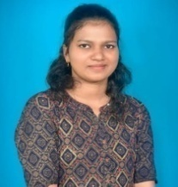
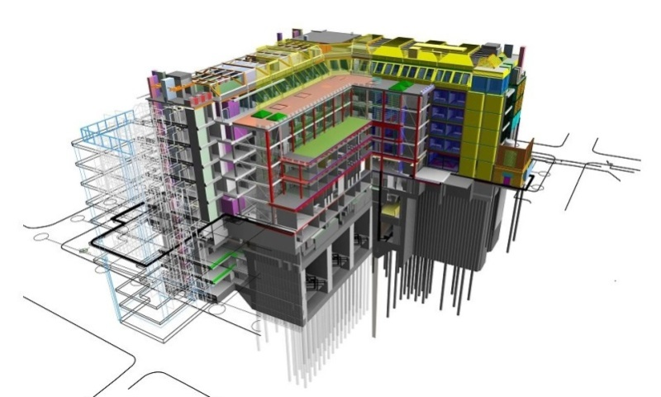
DEPARTMENT OF CIVIL ENGINEERING SUCCESS STORY
SUCCESS STORY
Miss. Pritam Subhash Patil
CEA, PWD Maharashtra
Mr. Shailesh Sarjerao Dalavi
Jr. Engineer, PWD Maharashtra
I stand here today filled with gratitude and excitement as I reflect on my journey to AMPV. Taking admission here has been a pivotal moment in my life, and I am honored to share with being student of this collage. When I first considered where to pursue my diploma, I was looking for more than just a place to acquire knowledge and skills. I sought a community—a place where passion for learning meets opportunities for growth, and I found exactly that here at AMPV.
Beyond academics, this college had offered me a vibrant and inclusive environment. I have had the privilege of interacting with fellow students from diverse backgrounds, each bringing their unique perspectives and experiences to our discussions. Together, we had engaged in lively debates, collaborated on projects, and formed friendships that helping since then till now. Moreover, the opportunities for practical learning and professional development at AMPV have been invaluable. Whether through internships, workshops, or industry collaborations, I have gained hands-on experience that complements the theoretical knowledge imparted in the classroom. That experiences have not only enhanced my skill set but also prepared me for the challenges and responsibilities that coming ahead in my career.
When I embarked on my journey to choose a college and a course, I was drawn to AMPV for its reputation of excellence in engineering education and its commitment to nurturing future leaders in the field of engineering. The faculty here, at AMPV were not just educators but industry experts who brought real-world experience into the classroom. Their passion for teaching and dedication to our success had instrumental in shaping my understanding of civil engineering principles and preparing me for the challenges coming in future. The personalized guidance and mentorship I had received have not only enhanced my academic journey but have also inspired me to push the boundaries of what I can achieve.
From the moment I stepped into this campus, I was welcomed by a faculty of civil engineering department, dedicated to nurturing talent and fostering intellectual curiosity. The professors here were not only experts in their fields but also mentors who went above and beyond to guide and inspire their students. Their unwavering support and encouragement have fueled my ambition and instilled in me the confidence to pursue my dreams.
The curriculum of the diploma in civil engineering program at this college is meticulously designed to provide a blend of theoretical knowledge and practical skills. I had the opportunity to engage in hands-on learning experiences through laboratory sessions, site visits, and industry internships. That experiences have not only deepened my understanding of civil engineering concepts but also have equipped me with the practical skills necessary to thrive in the professional world. Beyond the classroom, AMPV has provided me with numerous opportunities for personal and professional growth. From guest lectures by industry leaders to workshops on the latest technological advancements in civil engineering, I was able to stay updated with current trends and developments in the field. These experiences have not only enriched my learning but also inspired me to pursue continuous learning and professional development throughout my career.
BIM Model of a Hospital building under construction
ASHOKRAO MANE POLYTECHNIC, VATHAR PAGE NO 11

Slide 12
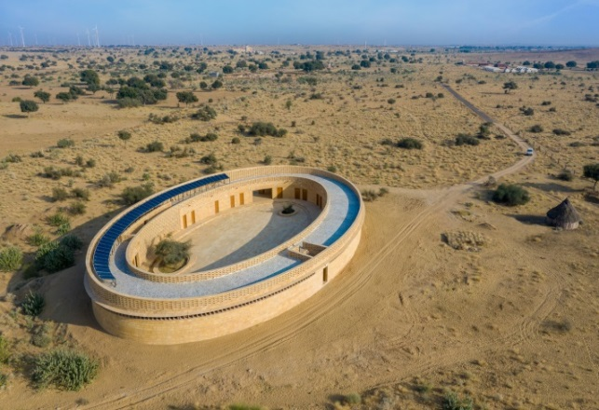
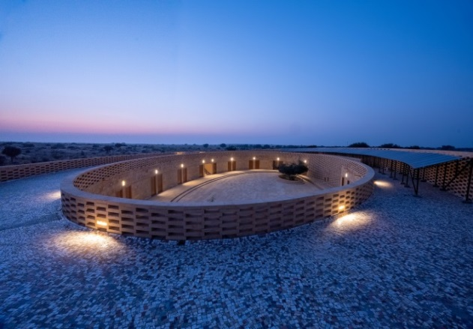
DEPARTMENT OF CIVIL ENGINEERING ABOUT THE THEME
This School Made of Sandstone in the Middle of The Thar Desert Needs no AC
Rajkumari Ratnavati Girls’ School, Rajasthan
In the heart of Jaisalmer, known as the “Golden City” for its remarkable yellow sandstone architecture, lies a revolutionary educational and architectural marvel. The Rajkumari Ratnavati Girls’ School stands as a testament to the fusion of visionary design and transformative education, offering hope and inspiration far beyond its geographical boundaries. More than a mere school, it symbolizes the potential of innovation, sustainability, and the relentless pursuit of knowledge.
An architectural marvel, located just a six-minute drive away from Jaisalmer’s famous Sam Dunes, has taken shape in Kanoi village, with an aim to educate girls and empower them. The Rajkumari Ratnavati Girls’ School is made of yellow sandstone, and surprisingly, has no air conditioners. Here, students can study and even play in the protected courtyard without worrying about the extreme weather. The school is visually impressive, with an oval-shaped structure that blends in the desert landscape. The building also comes with elements of sustainability. The school portion, known as the Gyaan Centre, accommodate 400 girls from kindergarten to Class X. The complex also has a textile museum and performance hall, as well as an exhibition space for artisans to sell their crafts. In another building, women will be trained in traditional arts like weaving and textiles to preserve dying handicrafts.
It took a decade for Michael Daube, founder of CITTA, a non-profit organization, to conceptualize the building, and help it materialize. Michael roped in US-based architect Diana Kellogg, who conceived the design. The solar panels on top of the building work as a canopy, and provide shade while simultaneously powering the building. A cooling system uses geothermal energy at night to cool the building during the day.
The courtyard in the complex can harvest 3.5 lakh liters of water and store it in its belly. The inner walls of the building are plastered with lime, which insulates the building. The local sandstone has been used for construction, which provides protection from extreme heat during the day, and warmth during evening hours. To allow enough room for ventilation, it has also revised drawings to make the classrooms and other offices bigger in size. This self-sufficiency model not only reduces operational costs but also showcases an exemplary model of sustainable education, setting a potent precedent for the future.
The Rajkumari Ratnavati Girls’ School champions climate consciousness, gender equality, and the boundless potential of architecture to shape transformative educational environments. This visionary endeavor goes beyond the confines of its walls, radiating positive influence through the community and beyond. Every brick of its oval frame echoes tales of resilience and progress. In reimagining the concept of a learning space, it defies conventional norms and underscores the harmony that can exist between environment, culture, and inclusivity. As the global community confronts pressing environmental issues and social disparities, the Rajkumari Ratnavati Girls’ School illuminates a forward path. It isn’t just a school but a blueprint for the evolution of educational institutions, an embodiment of how education and architecture can synergistically pave the way to a sustainable, equitable future.
The responsibility of the authenticity of the information in this Newsletter lies with the author. Views expressed by the author are solely theirs; they are neither the views of Civil Engineering Department nor are they endorsed by Civil Engineering Department. Queries, comments, feedback and information may be sent to ampcivil2009@gmail.com. Edited , Printed and Published by Mr. A. B. Warke, HOD, Civil Engineering Department , Ashokrao Mane Polytechnic, Vathar Tarf Vadgaon, 416112, Website – www.amietv.org.
ASHOKRAO MANE POLYTECHNIC, VATHAR PAGE NO 12

